Slide 1
Week 3

Slide 2
Limits on Parallel Performance
It would appear that the parallel time can be made arbitrarily small by making the decomposition finer in granularity.
There is an inherent bound on how fine the granularity of a computation can be. For example, in the case of multiplying a dense matrix with a vector, there can be no more than (n²) concurrent tasks.
Concurrent tasks may also have to exchange data with other tasks. This results in communication overhead. The tradeoff between the granularity of a decomposition and associated overheads often determines performance bounds.

Slide 3
Task Interaction Graphs
Subtasks generally exchange data with others in a decomposition. For example, even in the trivial decomposition of the dense matrix-vector product, if the vector is not replicated across all tasks, they will have to communicate elements of the vector.
The graph of tasks (nodes) and their interactions/data exchange (edges) is referred to as a task interaction graph.
Note that task interaction graphs represent data dependencies, whereas task dependency graphs represent control dependencies.

Slide 4
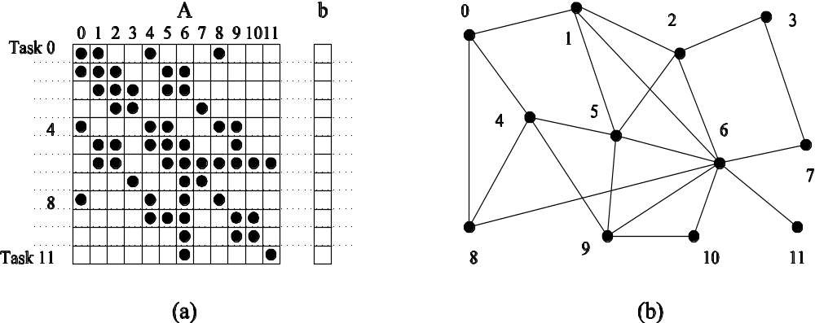
Task Interaction Graphs: An Example
Consider the problem of multiplying a sparse matrix A with a vector b. The following observations can be made:
As before, the computation of each element of the result vector can be viewed as an independent task.
Unlike a dense matrix-vector product though, only non-zero elements of matrix A participate in the computation.
If, for memory optimality, we also partition b across tasks, then one can see that the task interaction graph of the computation is identical to the graph of the matrix A (the graph for which A represents the adjacency structure).

Slide 5
Task Interaction Graphs, Granularity, and Communication
In general, if the granularity of a decomposition is finer, the associated overhead (as a ratio of useful work assocaited with a task) increases.
Example: Consider the sparse matrix-vector product example from previous foil. Assume that each node takes unit time to process and each interaction (edge) causes an overhead of a unit time.
Viewing node 0 as an independent task involves a useful computation of one time unit and overhead (communication) of three time units.
Now, if we consider nodes 0, 4, and 5 as one task, then the task has useful computation totaling to three time units and communication corresponding to four time units (four edges). Clearly, this is a more favorable ratio than the former case.

Slide 6
Processes and Mapping
In general, the number of tasks in a decomposition exceeds the number of processing elements available.
For this reason, a parallel algorithm must also provide a mapping of tasks to processes.
Note: We refer to the mapping as being from tasks to processes, as opposed to processors. This is because typical programming APIs, as we shall see, do not allow easy binding of tasks to physical processors. Rather, we aggregate tasks into processes and rely on the system to map these processes to physical processors. We use processes, not in the UNIX sense of a process, rather, simply as a collection of tasks and associated data.

Slide 7
Processes and Mapping
Appropriate mapping of tasks to processes is critical to the parallel performance of an algorithm.
Mappings are determined by both the task dependency and task interaction graphs.
Task dependency graphs can be used to ensure that work is equally spread across all processes at any point (minimum idling and optimal load balance).
Task interaction graphs can be used to make sure that processes need minimum interaction with other processes (minimum communication).

Slide 8
Processes and Mapping
An appropriate mapping must minimize parallel execution time by:
Mapping independent tasks to different processes.
Assigning tasks on critical path to processes as soon as they become available.
Minimizing interaction between processes by mapping tasks with dense interactions to the same process.
Note: These criteria often conflict eith each other. For example, a decomposition into one task (or no decomposition at all) minimizes interaction but does not result in a speedup at all! Can you think of other such conflicting cases?

Slide 9
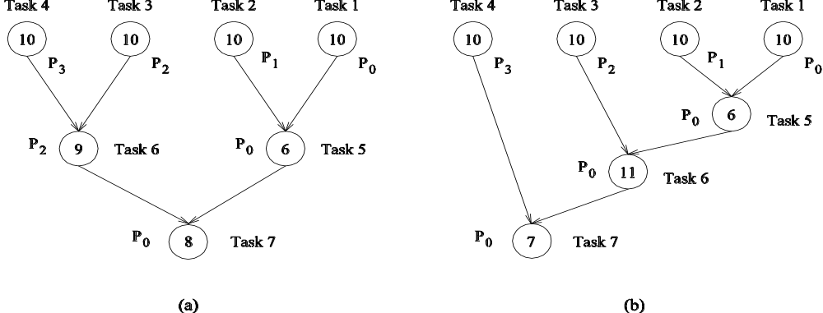
Processes and Mapping: Example
Mapping tasks in the database query decomposition to processes. These mappings were arrived at by viewing the dependency graph in terms of levels (no two nodes in a level have dependencies). Tasks within a single level are then assigned to different processes.

Slide 10
Decomposition Techniques
So how does one decompose a task into various subtasks?
While there is no single recipe that works for all problems, we present a set of commonly used techniques that apply to broad classes of problems. These include:
• recursive decomposition
• data decomposition
• exploratory decomposition
• speculative decomposition

Slide 11
Recursive Decomposition
Generally suited to problems that are solved using the divide-and-conquer strategy.
A given problem is first decomposed into a set of sub-problems.
These sub-problems are recursively decomposed further until a desired granularity is reached.

Slide 12
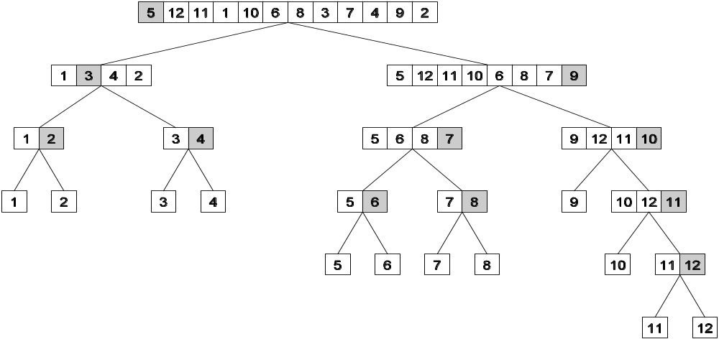
Recursive Decomposition: Example
A classic example of a divide-and-conquer algorithm on which we
can apply recursive decomposition is Quicksort.
In this example, once the list has been partitioned around the pivot, each sublist can be processed concurrently (i.e., each sublist represents an independent subtask). This can be repeated recursively.

Slide 13
Recursive Decomposition: Example
The problem of finding the minimum number in a given list (or indeed any other associative operation such as sum, AND, etc.) can be fashioned as a divide-and-conquer algorithm. The following algorithm illustrates this.
We first start with a simple serial loop for computing the minimum entry in a given list:
1. procedure SERIAL_MIN (A, n)
2. begin
3. min = A[0];
4. for i := 1 to n − 1 do
5. if (A[i] < min) min := A[i];
6. endfor;
7. return min;
8. end SERIAL_MIN

Slide 14
Recursive Decomposition: Example
We can rewrite the loop as follows:
1. procedure RECURSIVE_MIN (A, n)
2. begin
3. if ( n = 1 ) then
4. min := A [0] ;
5. else
6. lmin := RECURSIVE_MIN ( A, n/2 );
7. rmin := RECURSIVE_MIN ( &(A[n/2]), n - n/2 );
8. if (lmin < rmin) then
9. min := lmin;
10. else
11. min := rmin;
12. endelse;
13. endelse;
14. return min;
15. end RECURSIVE_MIN

Slide 15
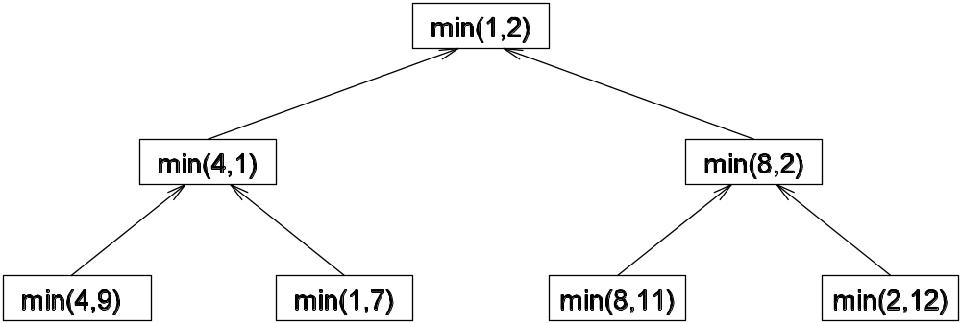
Recursive Decomposition: Example
The code in the previous foil can be decomposed naturally using a recursive decomposition strategy. We illustrate this with the following example of finding the minimum number in the set {4, 9, 1, 7, 8, 11, 2, 12}. The task dependency graph associated with this computation is as follows:

Slide 16
Data Decomposition
Identify the data on which computations are performed.
Partition this data across various tasks.
This partitioning induces a decomposition of the problem.
Data can be partitioned in various ways - this critically impacts performance of a parallel algorithm.

Slide 17
Data Decomposition: Output Data Decomposition
Often, each element of the output can be computed independently of others (but simply as a function of the input).
A partition of the output across tasks decomposes the problem naturally.

Slide 18
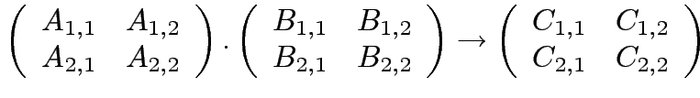




Output Data Decomposition: Example
Consider the problem of multiplying two n x n matrices A and B to yield matrix C. The output matrix C can be partitioned into four tasks as follows:
Task 1:
Task 2:
Task 3:
Task 4:

Slide 19
Output Data Decomposition: Example
A partitioning of output data does not result in a unique decomposition into tasks. For example, for the same problem as in previus foil, with identical output data distribution, we can derive the following two (other) decompositions:
Decomposition I | Decomposition II
Task 1: C_{1,1} = A_{1,1} B_{1,1} Task 2: C_{1,1} = C_{1,1} + A_{1,2} B_{2,1} Task 3: C_{1,2} = A_{1,1} B_{1,2} Task 4: C_{1,2} = C_{1,2} + A_{1,2} B_{2,2} Task 5: C_{2,1} = A_{2,1} B_{1,1} Task 6: C_{2,1} = C_{2,1} + A_{2,2} B_{2,1} Task 7: C_{2,2} = A_{2,1} B_{1,2} Task 8: C_{2,2} = C_{2,2} + A_{2,2} B_{2,2} | Task 1: C_{1,1} = A_{1,1} B_{1,1} Task 2: C_{1,1} = C_{1,1} + A_{1,2} B_{2,1} Task 3: C_{1,2} = A_{1,2} B_{2,2} Task 4: C_{1,2} = C_{1,2} + A_{1,1} B_{1,2} Task 5: C_{2,1} = A_{2,2} B_{2,1} Task 6: C_{2,1} = C_{2,1} + A_{2,1} B_{1,1} Task 7: C_{2,2} = A_{2,1} B_{1,2} Task 8: C_{2,2} = C_{2,2} + A_{2,2} B_{2,2}

Slide 20
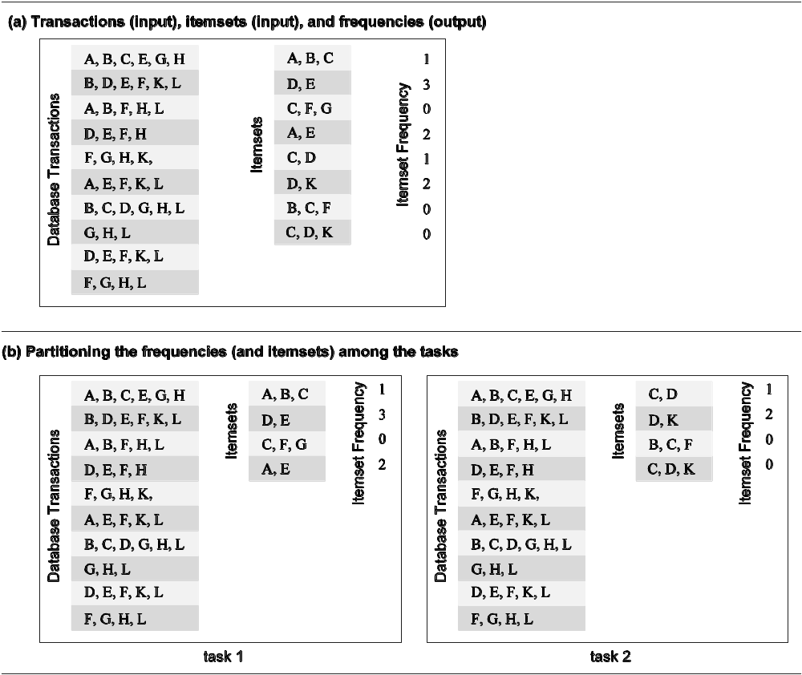
Output Data Decomposition: Example
Consider the problem of counting the instances of given itemsets in a database of transactions. In this case, the output (itemset frequencies) can be partitioned across tasks.

Slide 21
Output Data Decomposition: Example
From the previous example, the following observations can be made:
If the database of transactions is replicated across the processes, each task can be independently accomplished with no communication.
If the database is partitioned across processes as well (for reasons of memory utilization), each task first computes partial counts. These counts are then aggregated at the appropriate task.

Slide 22
Input Data Partitioning
Generally applicable if each output can be naturally computed as a function of the input.
In many cases, this is the only natural decomposition because the output is not clearly known a-priori (e.g., the problem of finding the minimum in a list, sorting a given list, etc.).
A task is associated with each input data partition. The task performs as much of the computation with its part of the data. Subsequent processing combines these partial results.

Slide 23
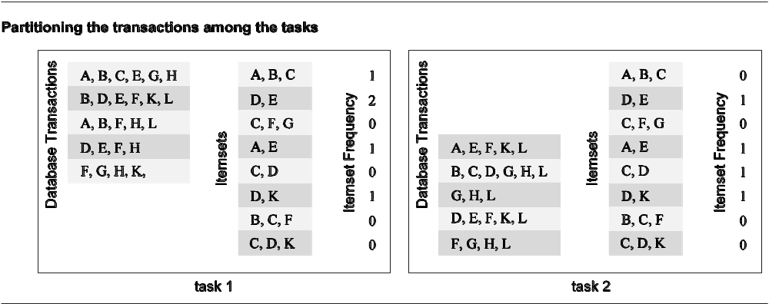
Input Data Partitioning: Example
In the database counting example, the input (i.e., the transaction set) can be partitioned. This induces a task decomposition in which each task generates partial counts for all itemsets. These are combined subsequently for aggregate counts.

Slide 24
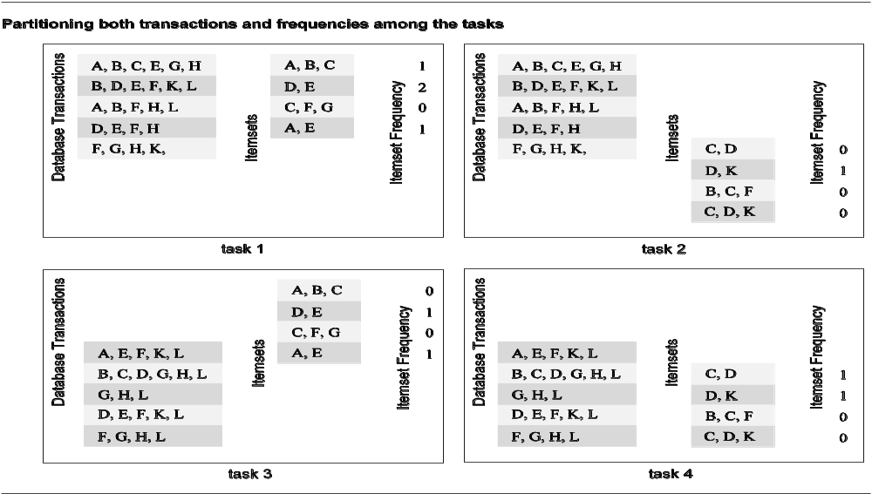
Partitioning Input and Output Data
Often input and output data decomposition can be combined for a higher degree of concurrency. For the itemset counting example, the transaction set (input) and itemset counts (output) can both be decomposed as follows:

Slide 25
Intermediate Data Partitioning
Computation can often be viewed as a sequence of transformation from the input to the output data.
In these cases, it is often beneficial to use one of the intermediate stages as a basis for decomposition.

Slide 26
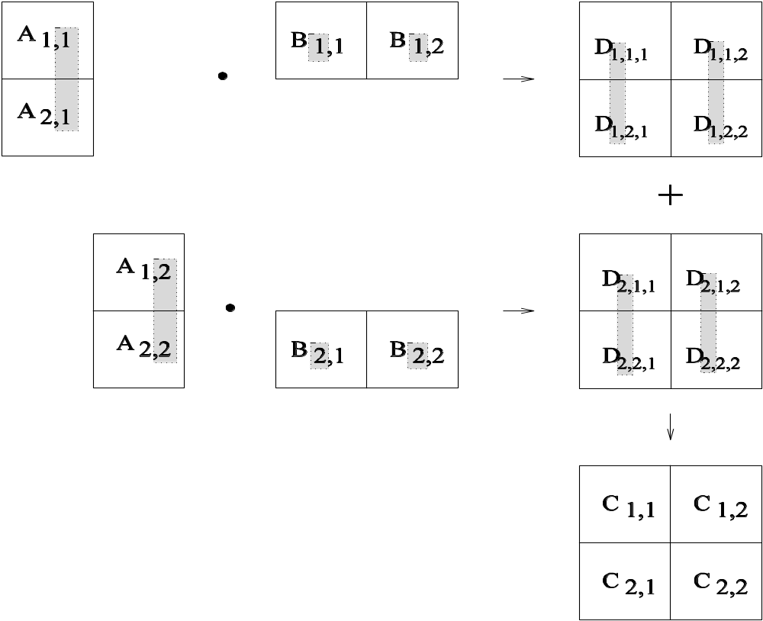
Intermediate Data Partitioning: Example
Let us revisit the example of dense matrix multiplication. We first show how we can visualize this computation in terms of intermediate matrices D.

Slide 27
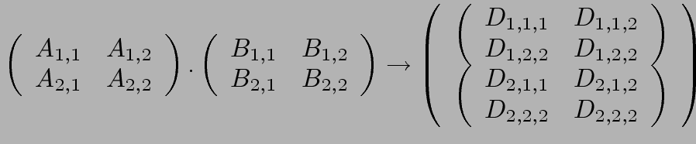
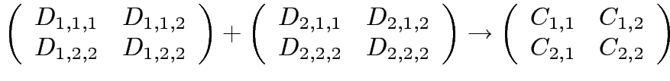
Intermediate Data Partitioning: Example
A decomposition of intermediate data structure leads to the following decomposition into 8 + 4 tasks:
Stage I
Stage II
Task 01: D_{1,1,1}= A_{1,1} B_{1,1} | Task 02: D_{2,1,1}= A_{1,2} B_{2,1}
Task 03: D_{1,1,2}= A_{1,1} B_{1,2} | Task 04: D_{2,1,2}= A_{1,2} B_{2,2}
Task 05: D_{1,2,1}= A_{2,1} B_{1,1} | Task 06: D_{2,2,1}= A_{2,2} B_{2,1}
Task 07: D_{1,2,2}= A_{2,1} B_{1,2} | Task 08: D_{2,2,2}= A_{2,2} B_{2,2}
Task 09: C_{1,1} = D_{1,1,1} + D_{2,1,1} | Task 10: C_{1,2} = D_{1,1,2} + D_{2,1,2}
Task 11: C_{2,1} = D_{1,2,1} + D_{2,2,1} | Task 12: C_{2,,2} = D_{1,2,2} + D_{2,2,2}

Slide 28
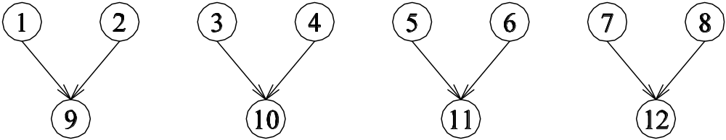
Intermediate Data Partitioning: Example
The task dependency graph for the decomposition (shown in previous foil) into 12 tasks is as follows:

Slide 29
The Owner Computes Rule
The Owner Computes Rule generally states that the process assined a particular data item is responsible for all computation associated with it.
In the case of input data decomposition, the owner computes rule imples that all computations that use the input data are performed by the process.
In the case of output data decomposition, the owner computes rule implies that the output is computed by the process to which the output data is assigned.

Slide 30
Exploratory Decomposition
In many cases, the decomposition of the problem goes hand-in-hand with its execution.
These problems typically involve the exploration (search) of a state space of solutions.
Problems in this class include a variety of discrete optimization problems (0/1 integer programming, QAP, etc.), theorem proving, game playing, etc.

Slide 31
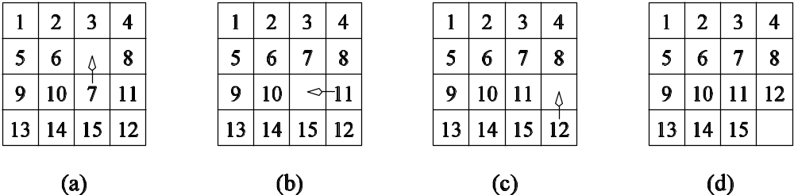
Exploratory Decomposition: Example
A simple application of exploratory decomposition is in the solution to a 15 puzzle (a tile puzzle). We show a sequence of three moves that transform a given initial state (a) to desired final state (d).
Of-course, the problem of computing the solution, in general, is much more difficult than in this simple example.

Slide 32
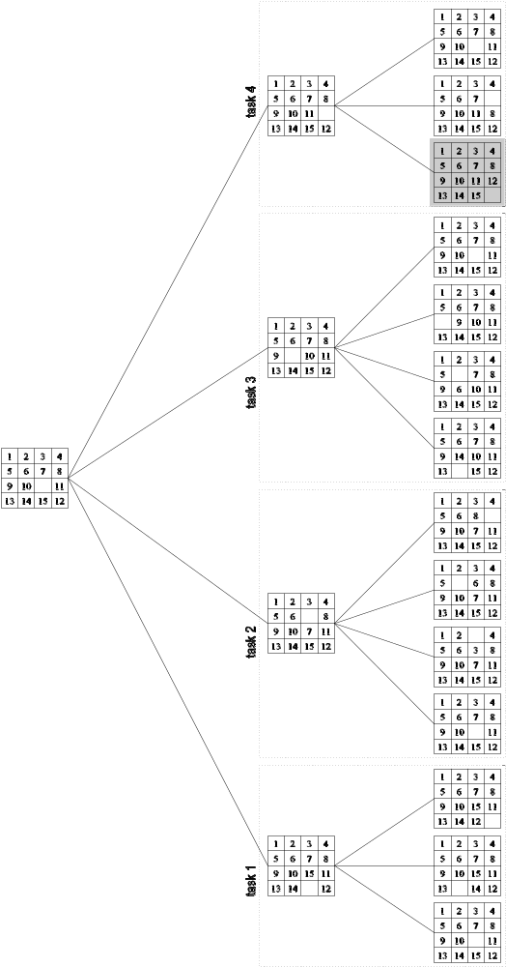
Exploratory Decomposition: Example
The state space can be explored by generating various successor states of the current state and to view them as independent tasks.

Slide 33
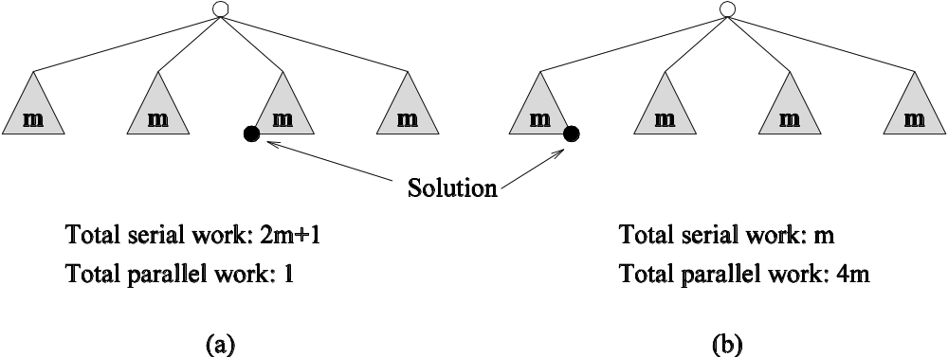
Exploratory Decomposition: Anomalous Computations
In many instances of exploratory decomposition, the decomposition technique may change the amount of work done by the parallel formulation.
This change results in super- or sub-linear speedups.

Slide 34
Speculative Decomposition
In some applications, dependencies between tasks are not known a-priori.
For such applications, it is impossible to identify independent tasks.
There are generally two approaches to dealing with such applications: conservative approaches, which identify independent tasks only when they are guaranteed to not have dependencies, and, optimistic approaches, which schedule tasks even when they may potentially be erroneous.
Conservative approaches may yield little concurrency and optimistic approaches may require roll-back mechanism in the case of an error.

Slide 35
Speculative Decomposition: Example
A classic example of speculative decomposition is in discrete event simulation.
The central data structure in a discrete event simulation is a time-ordered event list.
Events are extracted precisely in time order, processed, and if required, resulting events are inserted back into the event list.
Consider your day today as a discrete event system - you get up, get ready, drive to work, work, eat lunch, work some more, drive back, eat dinner, and sleep.
Each of these events may be processed independently, however, in driving to work, you might meet with an unfortunate accident and not get to work at all.
Therefore, an optimistic scheduling of other events will have to be rolled back.

Slide 36
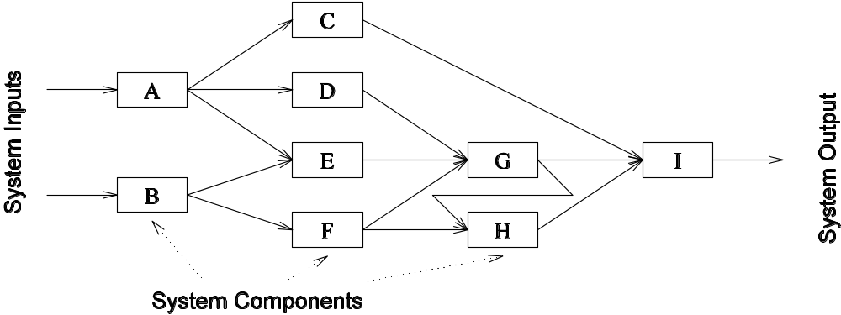
Speculative Decomposition: Example
Another example is the simulation of a network of nodes (for instance, an assembly line or a computer network through which packets pass). The task is to simulate the behavior of this network for various inputs and node delay parameters (note that networks may become unstable for certain values of service rates, queue sizes, etc.).

Slide 37
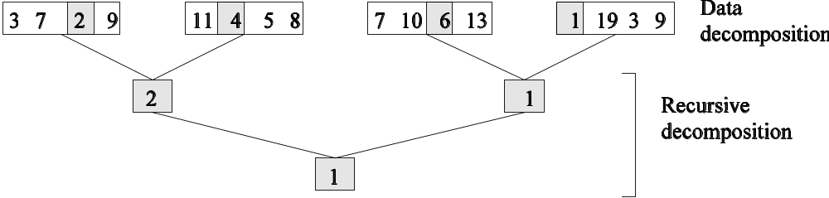
Hybrid Decompositions
Often, a mix of decomposition techniques is necessary for decomposing a problem. Consider the following examples:
In quicksort, recursive decomposition alone limits concurrency (Why?). A mix of data and recursive decompositions is more desirable.
In discrete event simulation, there might be concurrency in task processing. A mix of speculative decomposition and data decomposition may work well.
Even for simple problems like finding a minimum of a list of numbers, a mix of data and recursive decomposition works well.

Slide 38
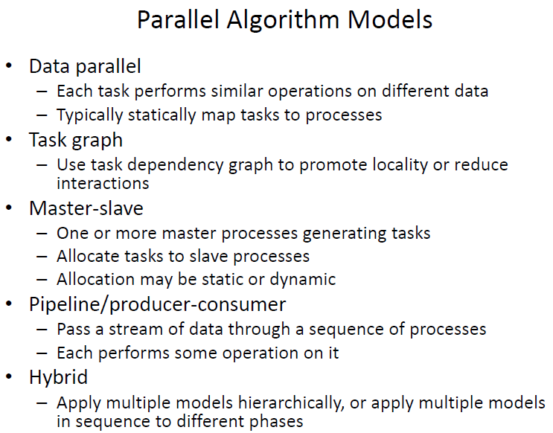

Slide 39
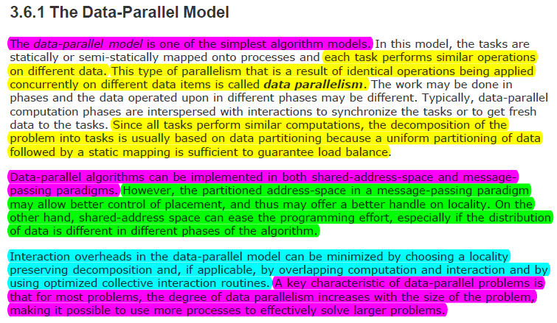
Introduction: 1-<number>

Slide 40
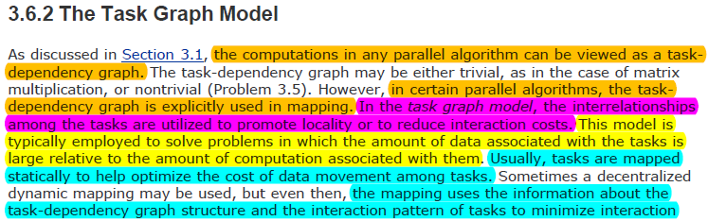
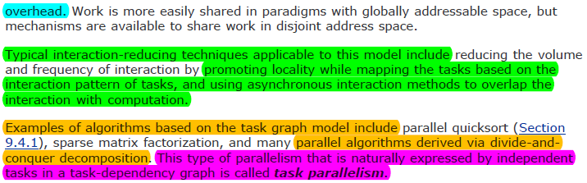
Introduction: 1-<number>

Slide 41
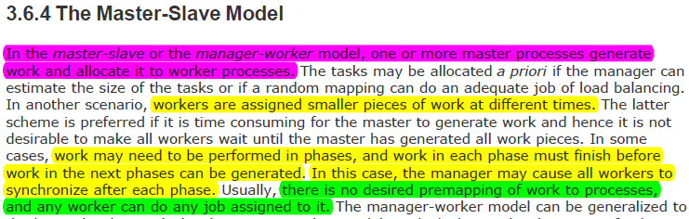
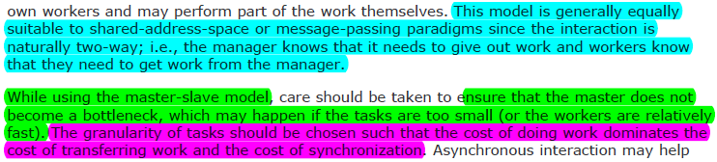
Introduction: 1-<number>

Slide 42
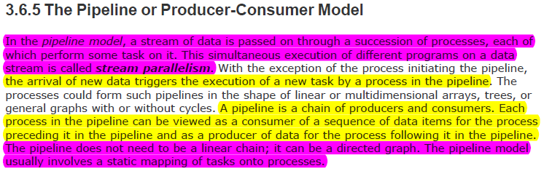
Introduction: 1-<number>

